Slide 1
Chapter 3 Describing Data Using Numerical Measures
A Course In Business Statistics
4th Edition

Slide 2
Chapter Goals
After completing this chapter, you should be able to:
Compute and interpret the mean, median, and mode for a set of data
Compute the range, variance, and standard deviation and know what these values mean
Construct and interpret a box and whiskers plot
Compute and explain the coefficient of variation and
z scores
Use numerical measures along with graphs, charts, and tables to describe data

Slide 3
Descriptive Statistics
With charts and graphs, we can have an idea about the distribution of the data. How the data is distributed among the values of the variables.
When we are concerned with describing the characteristics of the frequency distributions, we need some measures.
What are the characteristics?
Where is the center?
What is the range?
What is the shape of the distribution?

Slide 4
Summary Measures
Measures of Center and Location
Mean, median, mode, geometric mean, midrange
Other measures of Location
Weighted mean, percentiles, quartiles
Measures of Variation
Range, interquartile range, variance and standard deviation, coefficient of variation

Slide 5
Marks of Intr.Stats of Last Year (Make-up Exam)
0 | 0 | 60 | 85 | 90 | 60
0 | 25 | 75 | 70 | 60 | 90
0 | 60 | 74 | 35 | 67 | 85
0 | 0 | 72 | 87 | 36 | 0
60 | 35 | 30 | 65 | 70 | 0
0 | 70 | 20 | 85 | 95 | 70
60 | 87 | 65 | 60 | 72 | 89
0 | 60 | 86 | 60 | 60 | 90
0 | 80 | 60 | 60 | 82 | 0
72 | 95 | 95 | 85 | 60
60 | 70 | 60 | 85 | 30
60 | 60 | 0 | 75 | 65

Slide 6
Sorted Marks of Intr.Stats of Last Year (Make-up Exam)
0 | 0 | 60 | 60 | 72 | 87
0 | 20 | 60 | 65 | 74 | 87
0 | 25 | 60 | 65 | 75 | 89
0 | 30 | 60 | 65 | 75 | 90
0 | 30 | 60 | 67 | 80 | 90
0 | 35 | 60 | 70 | 82 | 90
0 | 35 | 60 | 70 | 85 | 95
0 | 36 | 60 | 70 | 85 | 95
0 | 60 | 60 | 70 | 85 | 95
0 | 60 | 60 | 70 | 85
0 | 60 | 60 | 72 | 85
0 | 60 | 60 | 72 | 86

Slide 7
Construct a Grouped Frequency Distribution to Obtain a Histogram
STURGES RULE
Min=0
Max=95
N=69
Interval width = (Max – Min) / k
k (Sturges) = 1 + 3.3 * log(N)
= 1 + 3.3 * log(69) = 7.068
Interval width = (95 – 0 ) / 7 = 13.57
Take 14 as the interval width

Slide 8
Grouped Frequency Distribution
Marks | Number of Students
0 less than 14 | 13
14 less than 28 | 2
28 less than 42 | 5
42 less than 56 | 0
56 less than 70 | 21
70 less than 84 | 13
84 less than 98 | 15

Slide 9
Histogram

Slide 10
No answers to the following questions
What is the success level of students?
How did Student A do in the exam?
What is the success level of the make-up exam compared to final exam?
How an individual mark is different from all the other values?
Where the marks are gathered?
How is the intensity of this gathering?
All these questions are answered with measures of central tendency, variation and distributional measures.

Slide 11
Summary Measures
Describing Data Numerically
Center and Location
Other Measures of Location
Variation
Mean
Range
Percentiles
Median
Interquartile Range
Quartiles
Mode
Variance
Weighted Mean
Standard Deviation
Coefficient of Variation

Slide 12
Measures of Central Tendency
By «central tendency» we mean the tendency of the observations to centre around a particular value.
Three measures of central tendency are commonly used in statistical analysis - the mode, the median, and the mean
Each measure is designed to represent a typical score

Slide 13
Measures of Central Tendency
the mode, the median, and the mean
The choice of which measure to use depends on:
the shape of the distribution (whether normal or skewed), and
the variable’s “level of measurement” (data are nominal, ordinal or interval).
the availability of the data (open-end or closed-end data)

Slide 14
From the Point of Measurement Levels
Level of measurement | Measure of central tendency
Nominal | Mode
Ordinal | Median and mode
Interval/Ratio | Mean, median and mode
Notes:
As discussed in Lecture 2: Data Types –
Nominal variables or categorical data is data that comprises of categories that cannot be rank ordered – each category is just different. Therefore you cannot measure the distance between values (i.e. Male and female) and so they have no mathematical qualities. Therefore, you cannot use median and mean – all you can say is how often the values occur and which occurs the most frequently (the mode).
Ordinal variables are the next hierarchical level up from nominal data and like nominal data, the data is based on categories. But the difference is that they can be ranked and ordered i.e. from good to bad or agree to disagree. Therefore, the same measure of mode can be used with the addition of the median – the middle occurring value or category.
Up from ordinal data in the hierarchy is interval and ratio data. In addition to the ability to be ranked (as with ordinal data) the distance between each value with interval and ratio data can be measured i.e. difference between 1.5m and 1.6m. Therefore, it can use all those for ordinal data (mode and median) with the addition of the mean. The mean requires actual mathematical values to calculate an average so scale data (interval and ratio) is the only variable type to provide a single mathematical value for each observation.

Slide 15
Some Basic Notations
X is a single raw score
X_{i} is to the i ^{th} score in a set
X _{n} is the last score in a set
Set consists of X ₁ , X ₂ ,….X_{n}
∑ X = X ₁ + X ₂ + …. + X _{n}

Slide 16
Measures of Center and Location
Overview
Center and Location
Mean
Median
Mode
Weighted Mean

Slide 17
Mean (Arithmetic Average)
The Mean is the arithmetic average of data values
Sample mean
Population mean
n = Sample Size
N = Population Size

Slide 18
Mean (Arithmetic Average)
(continued)
The most common measure of central tendency
Mean = sum of values divided by the number of values
Affected by extreme values (outliers)
0 1 2 3 4 5 6 7 8 9 10
0 1 2 3 4 5 6 7 8 9 10
Mean = 3
Mean = 4

Slide 19
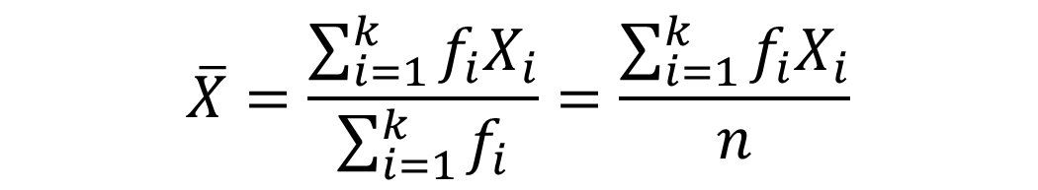
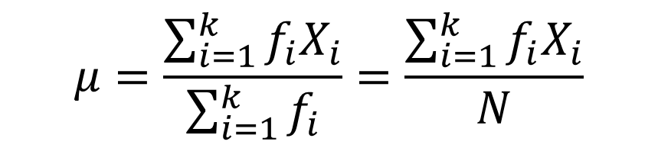
Mean (Ungrouped Frequency Distribution)
Sample mean
Population mean

Slide 20
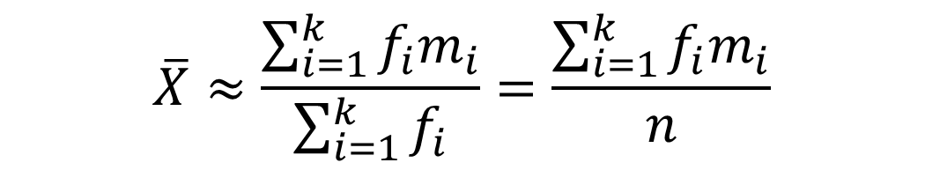
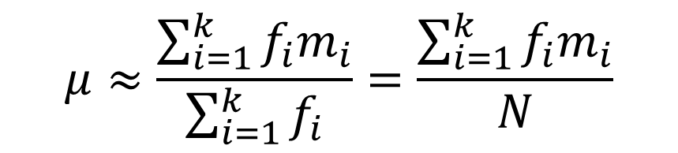
Mean (Grouped Frequency Distribution)
Sample mean
Population mean

Slide 21
Mode
Value that occurs most often. The most common observation in a group of scores
Not affected by extreme values
Can be obtained for open-end data
Used for either numerical or categorical data
There may be no mode
There may be several modes (unimodal, bimodal, or multimodal)
0 1 2 3 4 5 6 7 8 9 10 11 12 13 14
0 1 2 3 4 5 6
Mode = 5
No Mode

Slide 22
Mode (Categorical Data)
If the data is categorical (measured on the nominal scale) then only the mode can be calculated.
The most frequently occurring score (mode) is Vanilla.
Flavor | f
Vanilla | 28
Chocolate | 22
Strawberry | 15
Neapolitan | 8
Butter Pecan | 12
Rocky Road | 9
Fudge Ripple | 6

Slide 23
Mode (Ungrouped Data)
The mode can also be calculated with ordinal and higher data, but it often is not appropriate.
If other measures can be calculated, the mode would never be the first choice!
7, 7, 7, 20, 23, 23, 24, 25, 26 has a mode of 7, but obviously it doesn’t make much sense.
Notes:
-Remember, measures of central tendency look for the one number which best describe all of the numbers.

Slide 24
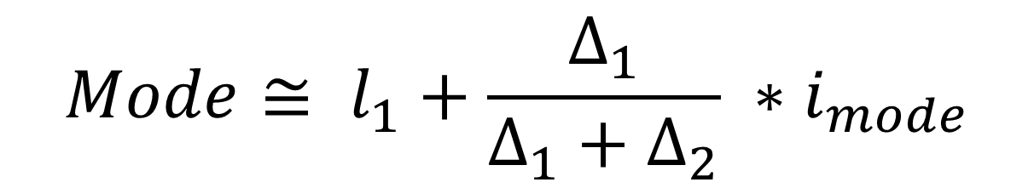
Mode (Grouped Data)
d1 the difference in frequencies between the modal class and the class immediately below, and d2 the difference in frequencies between the modal class and the class immediately above.
To be able to use this formula in a grouped frequency distribution, the 2 interval widths before and after the mode interval must be identical.

Slide 25
Median
The number that divides a distribution of scores exactly in half.
Better than mode because only one score can be median and the median will usually be around where most scores fall.
If data are perfectly normal, the mode is the median.
The median is computed when data are ordinal scale or when they are highly skewed.
Not affected by extreme values
Notes:
-Draw some distributions and show how 50% of the distribution falls to the left no matter what the shape is.

Slide 26
Median (Raw Data and Ungrouped Freq)
Median is the (N+1)/2 nd value in the data.
FIRSTLY, arrange all values in rank order from low to high (min to max)
If you have an odd number of scores pick the middle score. (7+1)/2 = 4th value is the median:
1 4 6 8 12 14 18
Median is 8
If you have an even number of scores, take the average of the middle two. (8+1)/2 = 4.5 ( 4th and 5th values)
1 4 6 7 8 12 14 16
Median is (7+8)/2 = 7.5
Notes:
-Scores must be in order to compute the median.

Slide 27
Median (Raw Data and Ungrouped Freq)
Not affected by extreme values
In an ordered array, the median is the “middle” number
If n or N is odd, the median is the middle number
If n or N is even, the median is the average of the two middle numbers
0 1 2 3 4 5 6 7 8 9 10
0 1 2 3 4 5 6 7 8 9 10
Median = 3
Median = 3

Slide 28
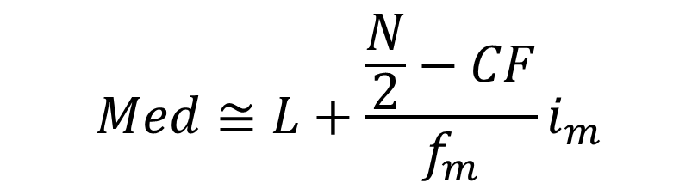
Median (Grouped Freq)
For grouped data, select the class containing the median (median class). The median may be approximated by
L : the lower boundary of the median class,
fm : the frequency of the median class,
CF : the sum of frequencies for all classes below the median class (a cumulative frequency).
i_m : interval width of the median class
$$Med≅L+\frac{\frac{N}{2}−CF}{f_{m}}i_{m}$$
Notes:
-Scores must be in order to compute the median.

Slide 29
Which measure of location is the “best”?
If data are perfectly normal, then the mean, median and mode are exactly the same.
I would prefer to use the mean whenever possible since it uses information from EVERY score. BUT...
Mean is generally used, unless extreme values (outliers) exist
Then median is often used, since the median is not sensitive to extreme values.
Example: Median home prices may be reported for a region – less sensitive to outliers

Slide 30
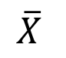
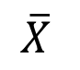
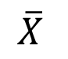
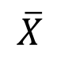
An example
Consider these means for weekly candy bar consumption.
X = {7, 8, 6, 7, 7, 6, 8, 7}
= (7+8+6+7+7+6+8+7)/8
= 7
X = {12, 2, 0, 14, 10, 9, 5, 4}
= (12+2+0+14+10+9+5+4)/8
= 7

Slide 31
On Friday, we will do some practical exercises on mean, mode and median.
See you on Friday.

Slide 32
Today we will see the other measures of central tendency such as:
Quartiles – Percentiles
Weighted Mean
Geometric Mean
and we will see when we use these measures.
Remember last week we learned about MEAN, MEDIAN and MODE?

Slide 33
Review Example
Five houses on a hill by the beach
House Prices: $2,000,000 500,000 300,000 100,000 100,000

Slide 34
Summary Statistics
House Prices: $2,000,000
500,000 300,000 100,000 100,000
Sum 3,000,000
Mean: ($3,000,000/5)
= $600,000
Median: middle value of ranked data = $300,000
Mode: most frequent value = $100,000

Slide 35
Shape of a Distribution
Describes how data is distributed
Symmetric or skewed
Left-Skewed
Symmetric
Right-Skewed
Mean < Median < Mode
Mean = Median = Mode
Mode < Median < Mean
(Longer tail extends to left)
(Longer tail extends to right)

Slide 36
Other Location Measures
Other Measures of Location
Percentiles
Quartiles
The p^{th} percentile in a data array:
p% are less than or equal to this value
(100 – p)% are greater than or equal to this value
(where 0 ≤ p ≤ 100)
1st quartile = 25th percentile
2nd quartile = 50th percentile
= median
3rd quartile = 75th percentile

Slide 37
Percentiles
For a set of measurements arranged in increasing order, the pth percentile is a value such that p percent of the measurements fall at or below the value, and (100-p) percent of the measurements fall at or above the value.

Slide 38
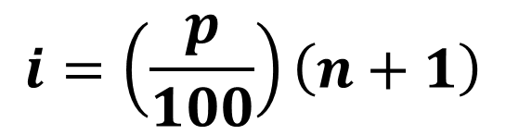
How to calculate the pth percentile
Step 1: Arrange the measurements in increasing order.
Step 2: Calculate the index
Step 3: (a) If i is an integer, this integer denotes the position of the pth percentile in the ordered arrangement.
(b) If i is not an integer, the pth percentile is the average of the measurements in positions i and i+1 in the ordered arrangement.
$$i=\left(\frac{p}{100}\right)\left(n+1\right)$$

Slide 39
Percentiles
An economist has randomly selected a sample of n=12 households from a Midwestern city and has determined last year’s income for each household as follows:
7,524 11,070 18,211 26,817 36,551
41,286 49,312 57,283 72,814 90,416 135,540 190,250
Example: The 50th percentile in an ordered array of 12 values is the value in the 6th and 7th positions: (since 6.5 is not an integer we take the mean of the 6th and the 7th values)

Slide 40
Quartiles
Quartiles split the ranked data into 4 equal groups
25%
25%
25%
25%
Q1
Q2
Q3
Example: Find the first quartile
Sample Data in Ordered Array: 11 12 13 16 16 17 18 21 22
(n = 9)
Q1 = 25th percentile, so find the (9+1) = 2.5 position
so use the value half way between the 2nd and 3rd values,
so Q1 = 12.5
25
100

Slide 41
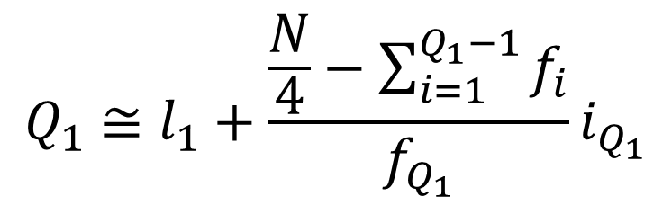
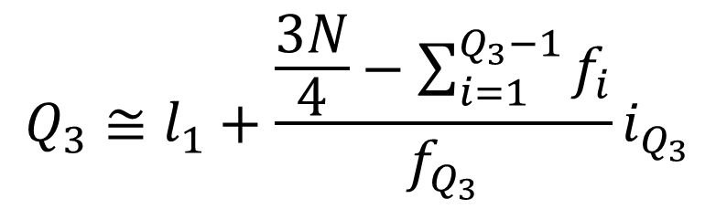
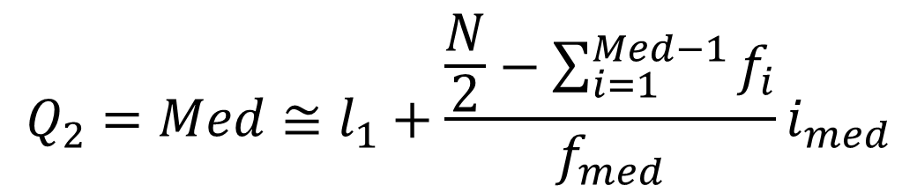
Quartiles in Grouped Data
$$Q_{1}≅l_{1}+\frac{\frac{N}{4}−\sum_{i=1}^{Q_{1}−1}{f_{i}}}{f_{Q_{1}}}i_{Q_{1}}$$
N/4
N/2
3N/4
$$Q_{2}=Med≅l_{1}+\frac{\frac{N}{2}−\sum_{i=1}^{Med−1}{f_{i}}}{f_{med}}i_{med}$$
$$Q_{3}≅l_{1}+\frac{\frac{3N}{4}−\sum_{i=1}^{Q_{3}−1}{f_{i}}}{f_{Q_{3}}}i_{Q_{3}}$$

Slide 42
Last week’s tutorial Example 2:
Salary distribution of workers ($)
Find the first, second and third quartiles.

Slide 43
Box and Whisker Plot
A Graphical display of data using 5-number summary:
Minimum -- Q1 -- Median -- Q3 -- Maximum
Example:
25% 25% 25% 25%

Slide 44
Shape of Box and Whisker Plots
The Box and central line are centered between the endpoints if data is symmetric around the median
A Box and Whisker plot can be shown in either vertical or horizontal format

Slide 45
Distribution Shape and Box and Whisker Plot
Left-Skewed
Symmetric
Right-Skewed
Q1
Q2
Q3
Q1
Q2
Q3
Q1
Q2
Q3

Slide 46
Box-and-Whisker Plot Example
Below is a Box-and-Whisker plot for the following data: 0 2 2 2 3 3 4 5 5 10 27
This data is very right skewed, as the plot depicts
Min Q1 Q2 Q3 Max
0 2 3 5 27

Slide 47
Other Types of Means
Weighted Mean
Geometric Mean
Harmonic Mean
Squared Mean

Slide 48
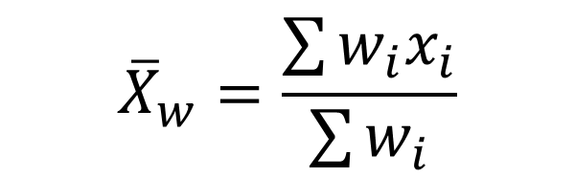
Weighted Mean
A mean where different measurements are
given with different weights based on their importance
Example: AGNO Calculation
Weighted Grade Point Average:
Marks | Credits
5 | 4
6 | 2
7 | 3
8 | 4
$${\overline{X}}_{w}=\frac{\sum{w_{i}x_{i}}}{\sum{w_{i}}}$$

Slide 49

Geometric Mean
Used when we have a geometric series such as growth rates, population growth rates, compound interest rates...
In such cases arithmetic mean is not a good measure.
$$G=\sqrt[N]{X_{1}X_{2}⋯X_{N}}$$

Slide 50
Example
The Standard & Poor’s 500 stock index is a commonly used measure of stock market performance in the United States. In the table below, we give the value of the S&P 500 index on the first day of market trading for each year from 2000 to 2005.
Year S&P 500 Index
2000 1,455.22
2001 1,283.27
2002 1,154.67
2003 909.03
2004 1,108.48
2005 1,211.92
Source: http://table.finance.yahoo.com.

Slide 51
1) What are the percentage changes (rates of return) for the S&P 500 index for the years from 2000 to 2001 and from 2001 to 2002 and so on?
2) Calculate the mean return for the S&P 500 index over the period from 2000 to 2005.
3) Suppose that an investment of $1,000,000 is made in 2000 and that the portfolio performs with returns equal to those of the S&P 500 index. What is the investment portfolio worth in 2006?

Slide 52
See you on Friday.
Please solve the problems, at least try, given in the handouts.

Slide 53
Measures of Variation
Variation
Range
Variance
Standard Deviation
Coefficient of Variation
Interquartile
Range
Population
Variance
Population
Standard
Deviation
Sample
Variance
Sample
Standard
Deviation

Slide 54
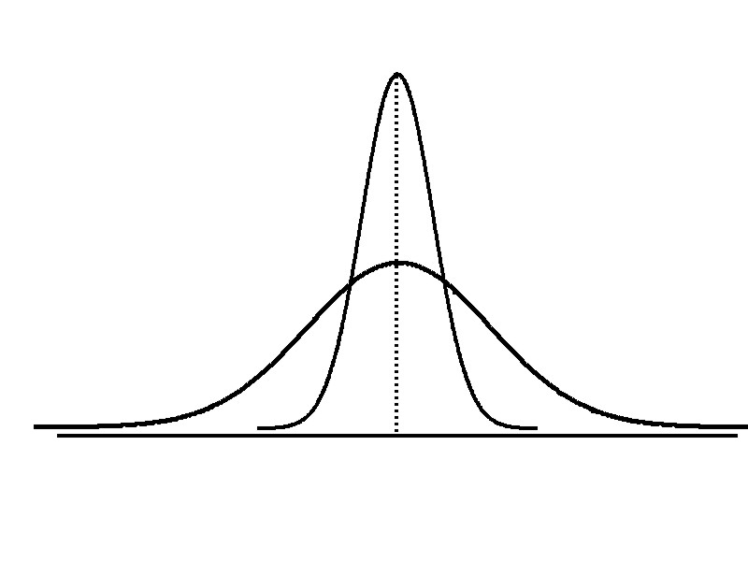
Variation
Measures of variation give information on the spread or variability of the data values.
Same center,
different variation

Slide 55
Range
Simplest measure of variation
Difference between the largest and the smallest observations:
Range = x_{maximum} – x_{minimum}
Example:
0 1 2 3 4 5 6 7 8 9 10 11 12 13 14
Range = 14 - 1 = 13

Slide 56
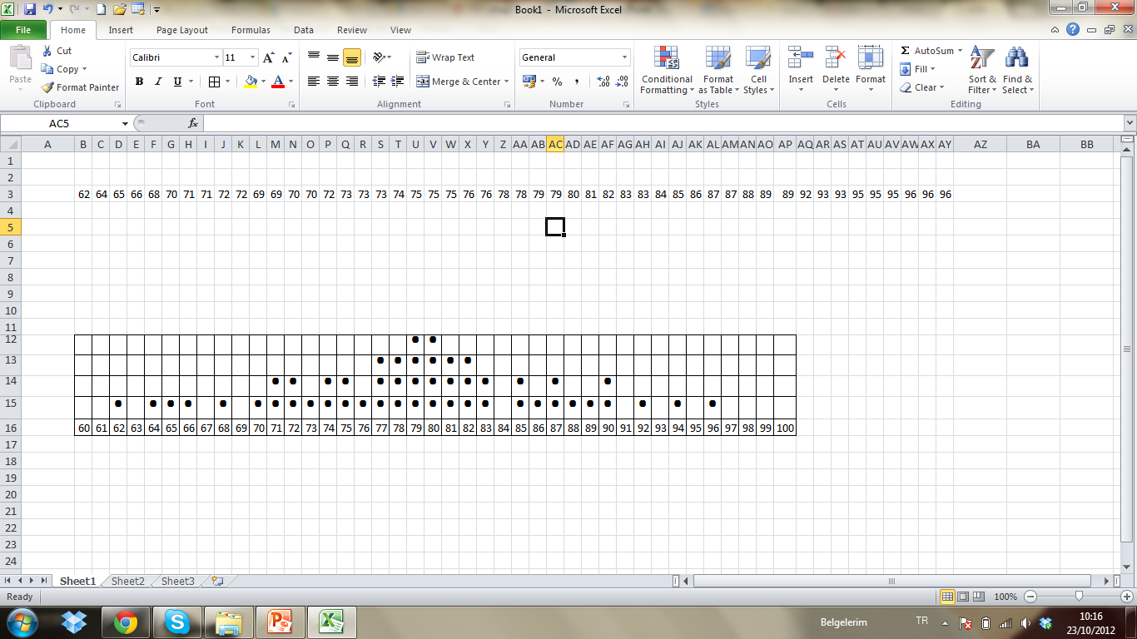
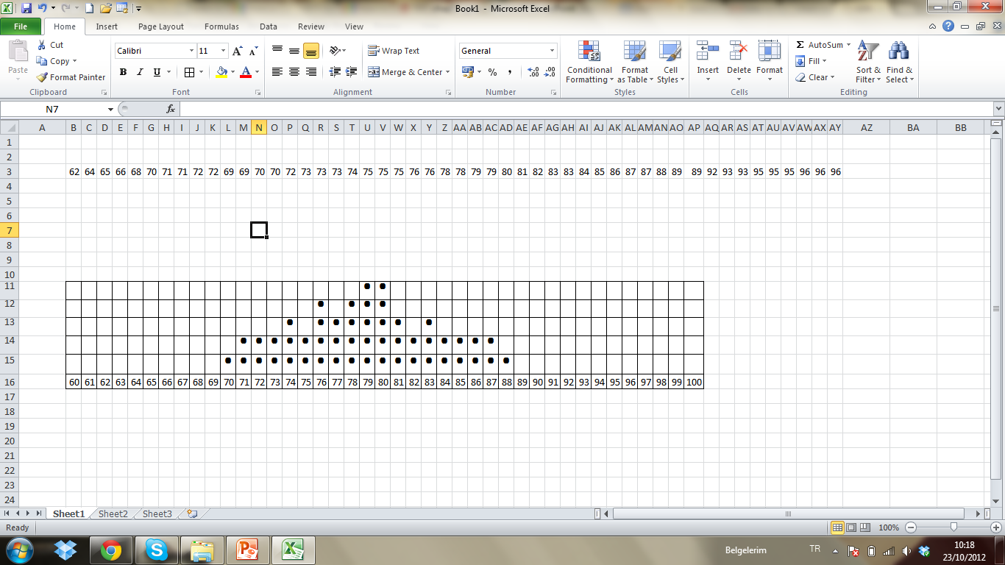
Compare the 2 dot-diagrams.
What seems to you the most striking difference between the two distributions?
A
B

Slide 57
The Range
1) The observed values in B are far less spread out than they are in A. Compare the ranges:
In A, range = 96-62 = 34
In B, range = 88-70 = 18
Range is the simplest measure of dispersion.
However we cannot trust range much. Why?
It depends totally on just two values: The smallest and largest. These may be outliers.

Slide 58
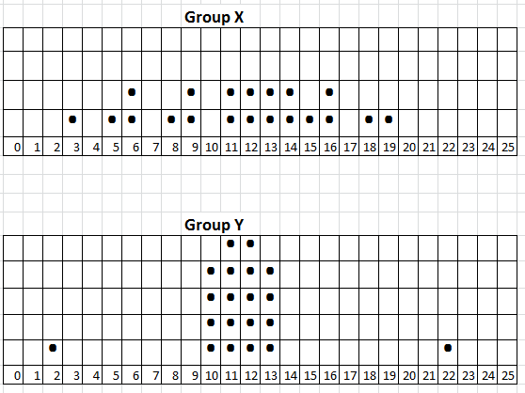
Which of the two distributions is the more dispersed? Which range is bigger?
Range (X) = 19-3=16
Range (Y) = 22-2=20

Slide 59
Disadvantages of the Range
Sensitive to outliers
Ignores the way in which data are distributed
1,1,1,1,1,1,1,1,1,1,1,2,2,2,2,2,2,2,2,3,3,3,3,4,5
Range = 5 - 1 = 4
1,1,1,1,1,1,1,1,1,1,1,2,2,2,2,2,2,2,2,3,3,3,3,4,120
Range = 120 - 1 = 119
7 8 9 10 11 12
7 8 9 10 11 12
Range = 12 - 7 = 5
Range = 12 - 7 = 5

Slide 60
Therefore, to overcome the disadvantages of the range we use a fairer measure of dispersion by taking a kind of «mini range» from nearer the centre of a distribution.
This is the interquartile range.

Slide 61
Interquartile Range (fourth spread)
Can eliminate some outlier problems by using the interquartile range (fourth spread).
Eliminate some high-and low-valued observations and calculate the range from the remaining values.
Interquartile range = 3rd quartile – 1st quartile

Slide 62
Interquartile Range
Example:
Median
(Q2)
X
X
Q1
Q3
minimum
maximum
25% 25% 25% 25%
12 30 45 57 70
Interquartile range
= 57 – 30 = 27

Slide 63
Interquartile Range Versus Range
Range (X) = 19-3=16
Range (Y) = 22-2=20
IQR (X) = 14.5-8.5=6
IQR (Y) = 12.5-10.5=2

Slide 64
You will no doubt agree that the inter-quartile range gives a more reasonable indication of the distribution than does the full range.
Now we will focus on the measure of dispersion that is more commonly used than any other: the STANDARD DEVIATION.
Like the mean, the standard deviation takes all the observed values into account.

Slide 65
Which of these sets of values would you expect to have the larger standard deviation?
(a) 6 24 37 49 64 (mean = 36)
(b) 111 114 117 118 120 (mean=116)
The values in (a) are more dispersed than those in (b), so we can expect the standard deviation to be larger.
Let’s see how it works:

Slide 66
in (b) 111 114 117 118 120 (mean=116)
Deviation from the mean 116:
-5 -2 +1 +2 +4
Now we cannot simply take an average of the deviations. Why?
They add up to zero! So to overcome this we square each deviation:
25 4 1 4 16
The mean of these squared deviations is called VARIANCE

Slide 67
Variance
Average of squared deviations of values from the mean
Sample variance:
Population variance:

Slide 68
But!
Variance is in squared values of our data:
Squared marks
Squared TL
Squared meters (for heigths)
and so on....
What would you do in this case to get the measure of dispersion back into the same units as the observed values?
Take the square root? So that is called the STANDARD DEVIATION

Slide 69
Standard Deviation
Most commonly used measure of variation
Shows variation about the mean
Has the same units as the original data
Sample standard deviation:
Population standard deviation:

Slide 70
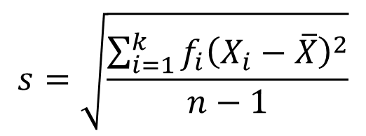
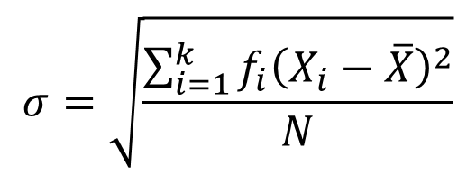
Standard deviation (Ungrouped Frequency Distribution)
Sample standard deviation
Population standard deviation
$$s=\sqrt{\frac{\sum_{i=1}^{k}{{f_{i}\left(X_{i}−\overline{X}\right)}^{2}}}{n−1}}$$
$$σ=\sqrt{\frac{\sum_{i=1}^{k}{{f_{i}\left(X_{i}−\overline{X}\right)}^{2}}}{N}}$$

Slide 71
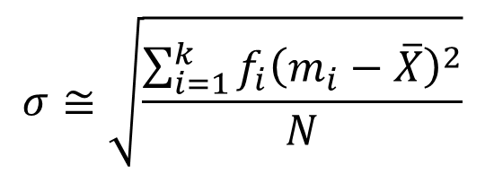
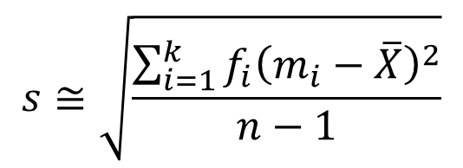
Standard deviation (Grouped Frequency Distribution)
Sample standard deviation
Population standard deviation
$$s≅\sqrt{\frac{\sum_{i=1}^{k}{{f_{i}\left(m_{i}−\overline{X}\right)}^{2}}}{n−1}}$$
$$σ≅\sqrt{\frac{\sum_{i=1}^{k}{{f_{i}\left(m_{i}−\overline{X}\right)}^{2}}}{N}}$$

Slide 72
Calculation Example: Sample Standard Deviation
Sample Data (X_{i}) : 10 12 14 15 17 18 18 24
n = 8 Mean = x = 16

Slide 73
Comparing Standard Deviations
Data A
Mean = 15.5
s = 3.338
11 12 13 14 15 16 17 18 19 20 21
Data B
Mean = 15.5
s = .9258
11 12 13 14 15 16 17 18 19 20 21
Data C
Mean = 15.5
s = 4.57
11 12 13 14 15 16 17 18 19 20 21

Slide 74
Coefficient of Variation
Measures relative variation and, unlike the standard deviation and the variance, it is not affected by the unit of measurement
Always in percentage (%)
Shows variation relative to mean
Is used to compare two or more sets of data measured in different units
Population Sample

Slide 75
Comparing Coefficient of Variation
Stock A:
Average price last year = $50
Standard deviation = $5
Stock B:
Average price last year = $100
Standard deviation = $5
Both stocks have the same standard deviation, but stock B is less variable relative to its price

Slide 76
The Empirical Rule
If the data distribution is bell-shaped, then the interval:
contains about 68% of the values in the population or the sample
68%

Slide 77
The Empirical Rule
contains about 95% of the values in the population or the sample
contains about 99.7% of the values in the population or the sample
95%
99.7%

Slide 78
Tchebysheff’s Theorem
Regardless of how the data are distributed, at least (1 - 1/k²) of the values will fall within k standard deviations of the mean (k>1)
Examples:
(1 - 1/2²) = 75% …........ k=2 (μ ± 2σ)
(1 - 1/3²) = 89% ………. k=3 (μ ± 3σ)
At least
within

Slide 79
Standardized Data Values
A standardized data value refers to the number of standard deviations a value is from the mean
Standardized data values are sometimes referred to as z-scores

Slide 80
Standardized Population Values
where:
x = original data value
μ = population mean
σ = population standard deviation
z = standard score
(number of standard deviations x is from μ)

Slide 81
Standardized Sample Values
where:
x = original data value
x = sample mean
s = sample standard deviation
z = standard score
(number of standard deviations x is from μ)

Slide 82
Using Microsoft Excel
Descriptive Statistics are easy to obtain from Microsoft Excel
Use menu choice: tools / data analysis / descriptive statistics
Enter details in dialog box

Slide 83
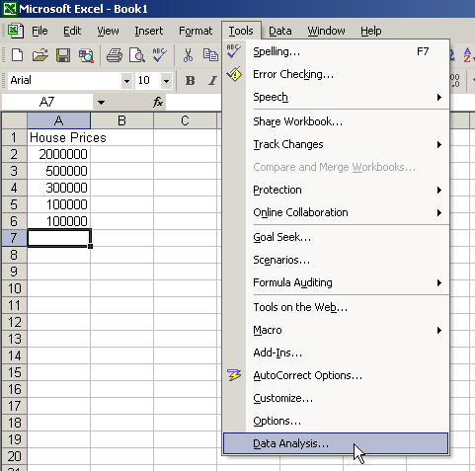
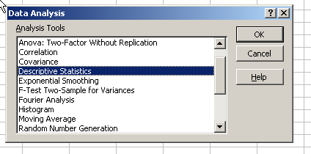
Using Excel
Use menu choice: tools / data analysis / descriptive statistics

Slide 84
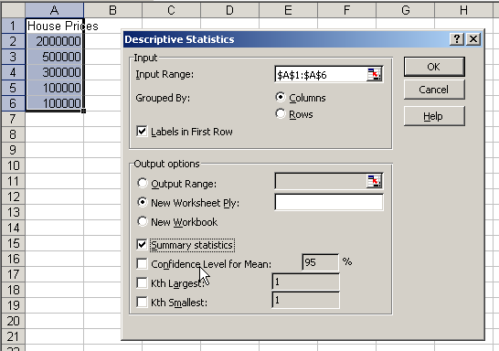
Using Excel
(continued)
Enter dialog box details
Check box for summary statistics
Click OK

Slide 85
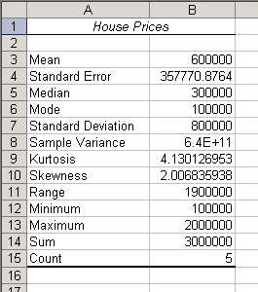
Excel output
Microsoft Excel
descriptive statistics output,
using the house price data:
House Prices: $2,000,000
500,000 300,000 100,000 100,000

Slide 86
Chapter Summary
Described measures of center and location
Mean, median, mode, geometric mean, midrange
Discussed percentiles and quartiles
Described measure of variation
Range, interquartile range, variance,
standard deviation, coefficient of variation
Created Box and Whisker Plots

Slide 87
Chapter Summary
(continued)
Illustrated distribution shapes
Symmetric, skewed
Discussed Tchebysheff’s Theorem
Calculated standardized data values

